Slide 1
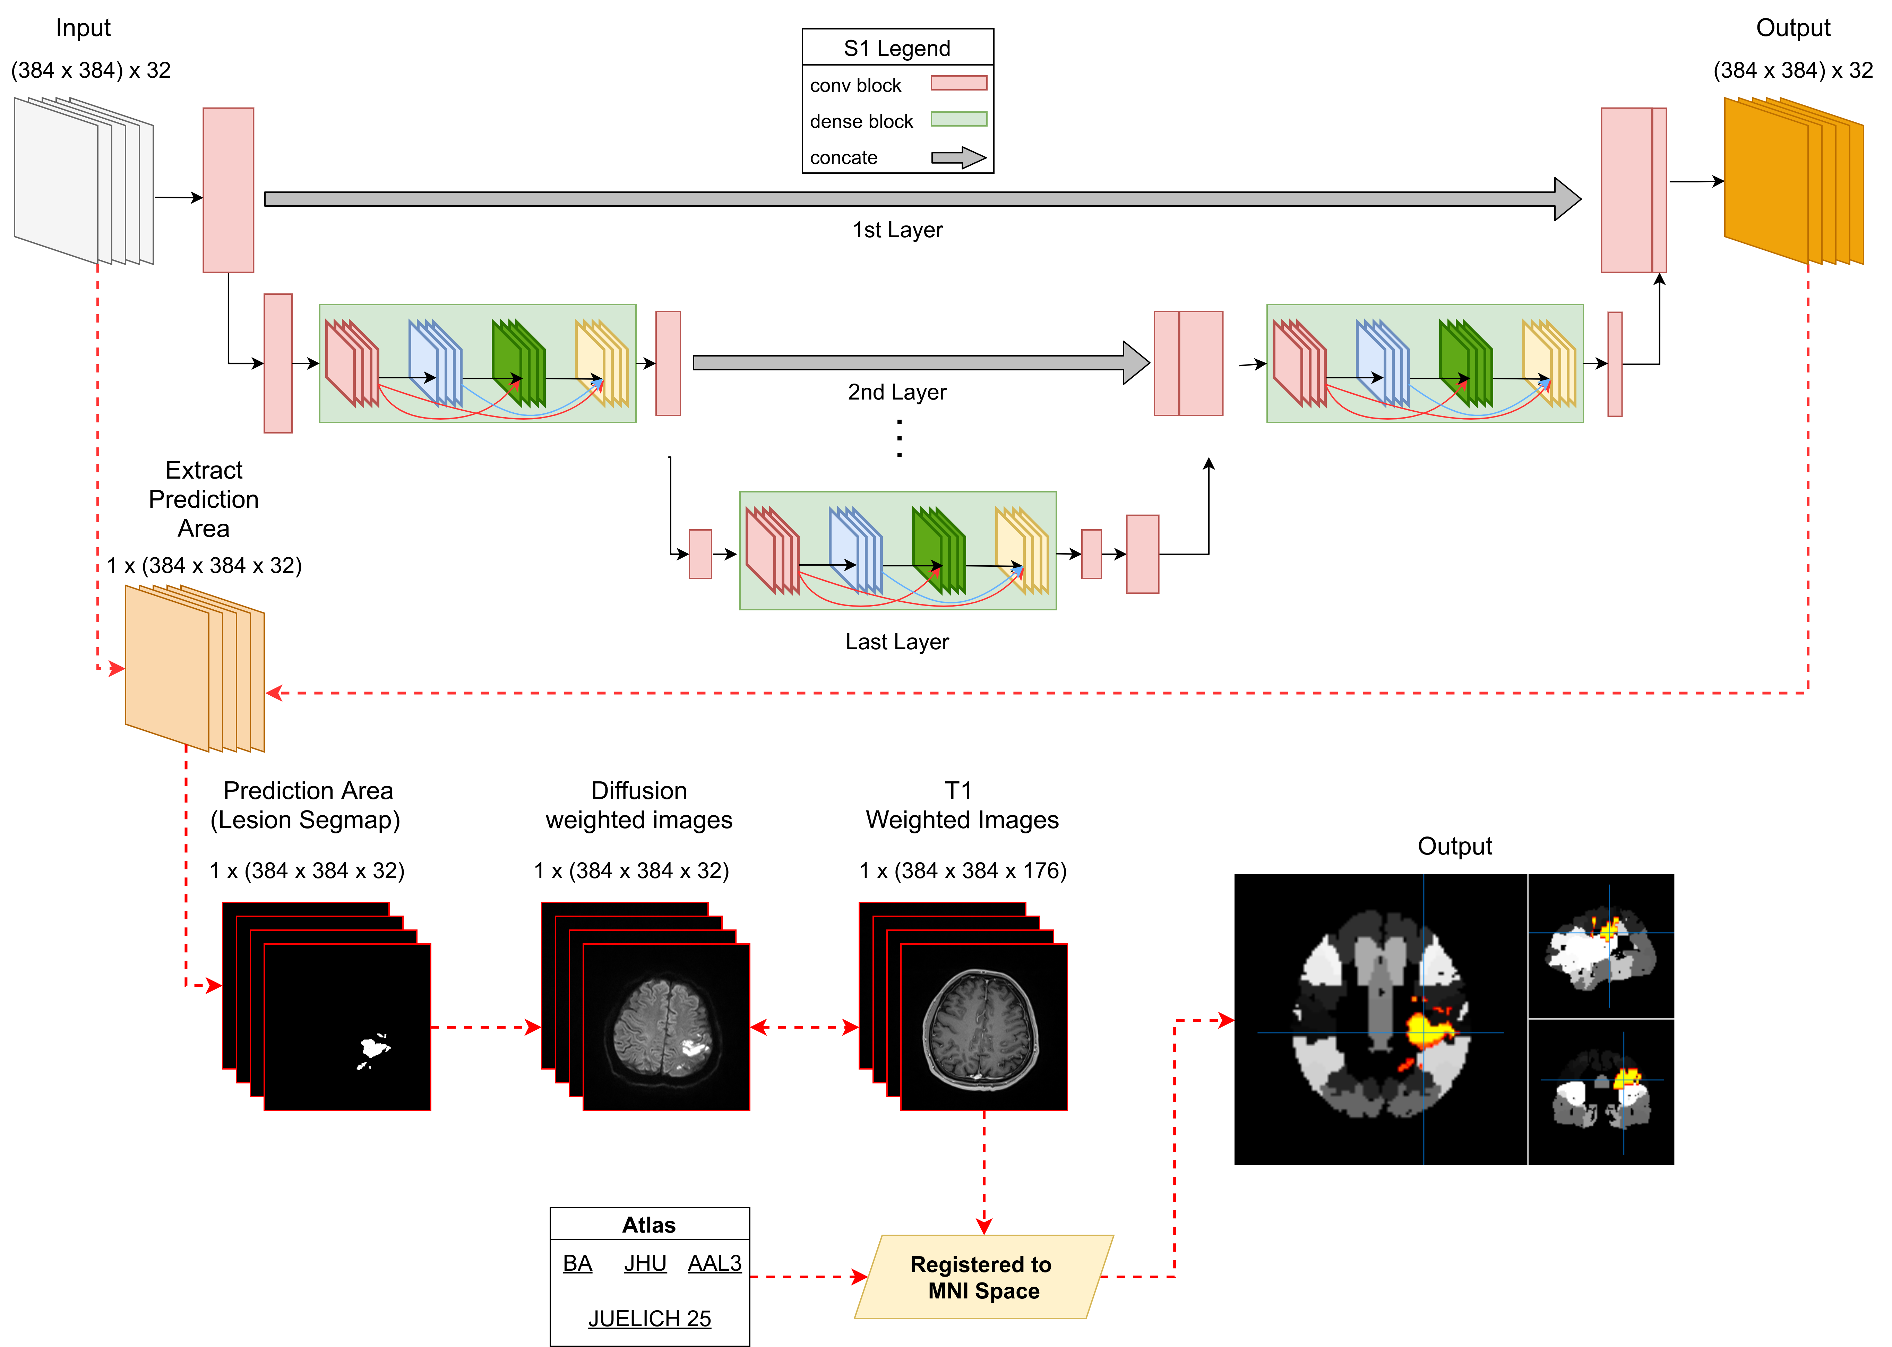
S1-SGD-Net + Atlas

Slide 2
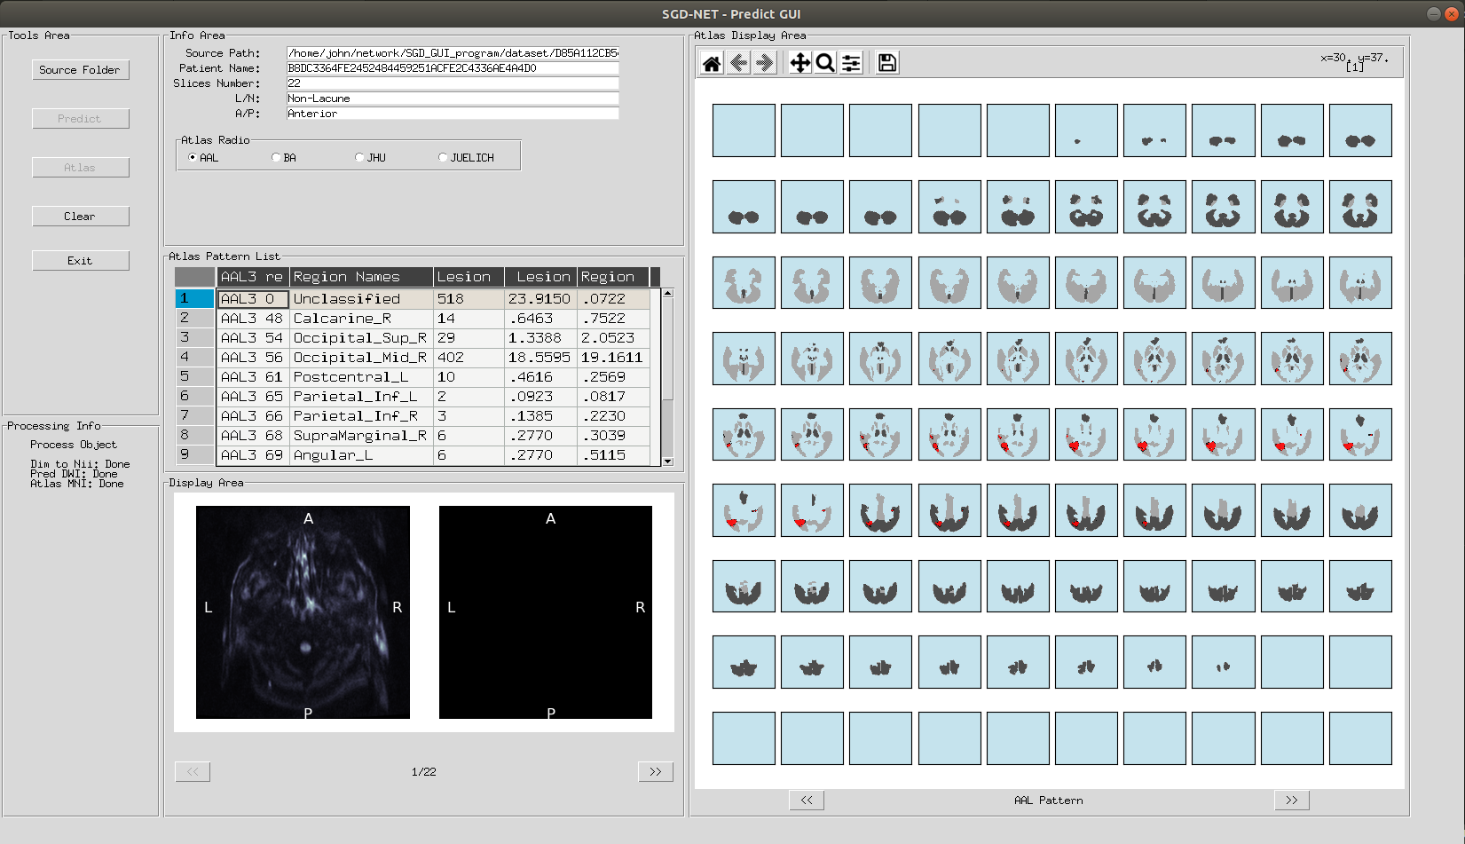
GUI for S1-SGD-Net + Atlas

Slide 3
PreTrain - SGDNet
Negative Image - no0001~no0050
Lesion Image - Black Slice

Slide 4
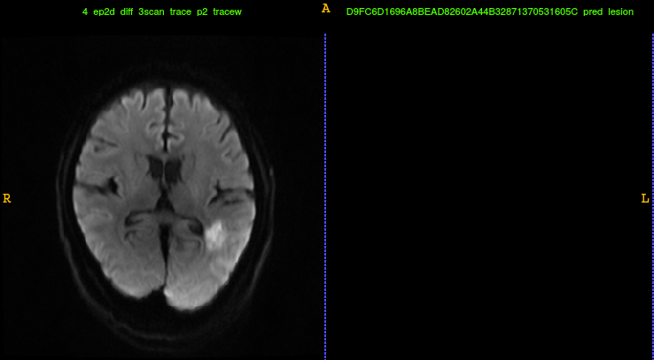
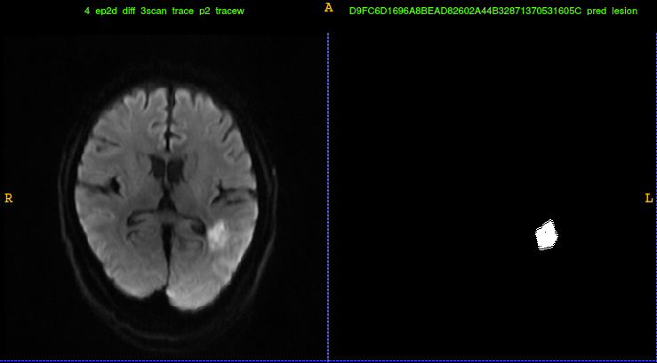
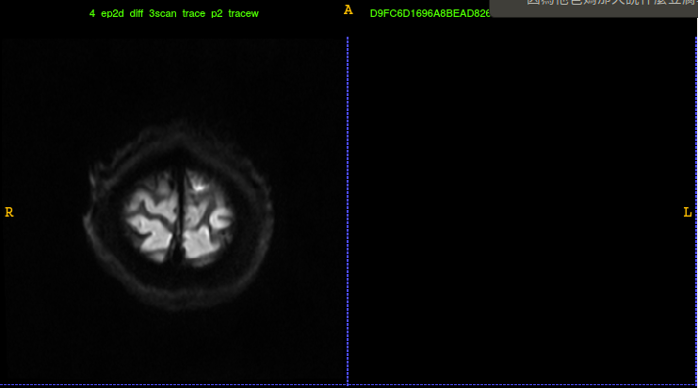
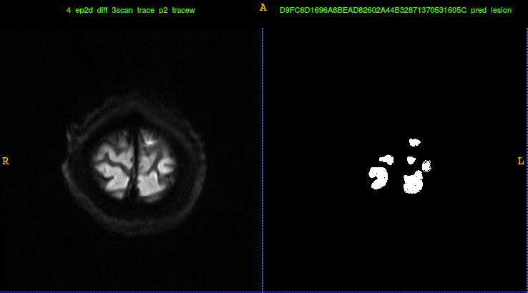

Slide 5
SGD-Net GUI
function | state
Dicom to nii | V
Predict dwi | V
Display dwi & Predict lesion | V
Nii to MNI Atlas | V
Switch Atlas Pattern | V
List Atlas info | V
Save Atlas Image | V
Optimized | -
SSH Connected | V

Slide 6
model adjust
loss funciton : remove smooth value
negative data: 50(40,10) -> 20(15,5)

Slide 7
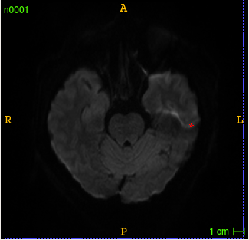
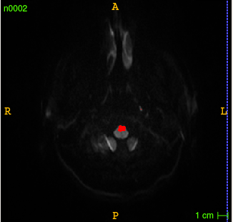
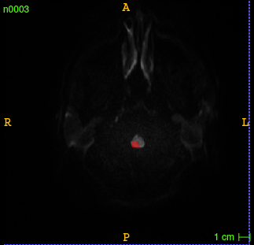
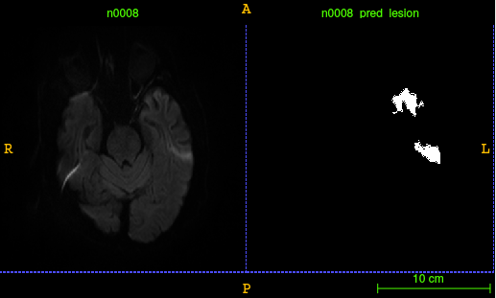
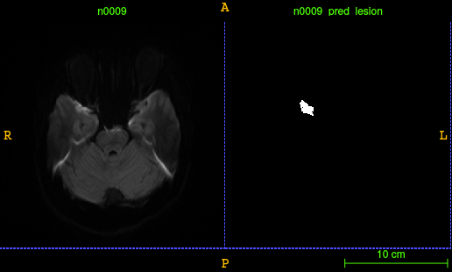
focal tversky loss initialization adjust - False Negative

Slide 8
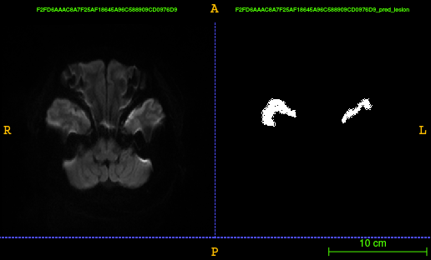
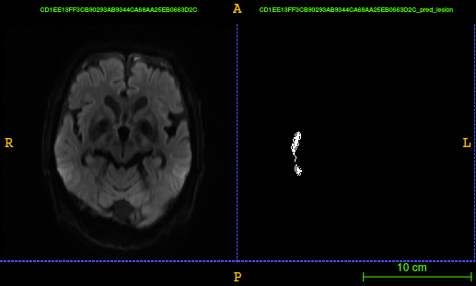
focal tversky loss initialization adjust - False Negative

Slide 9
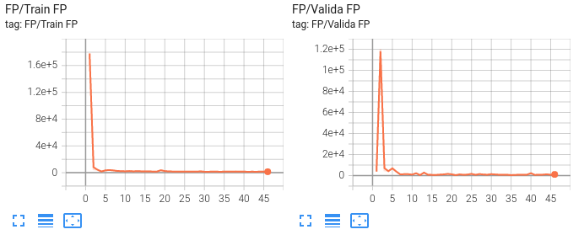
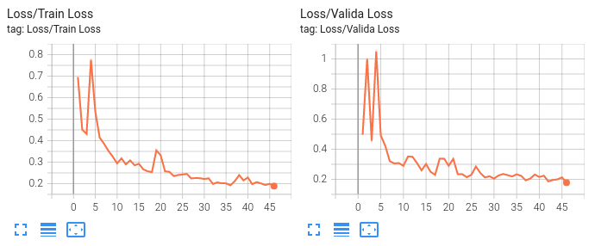
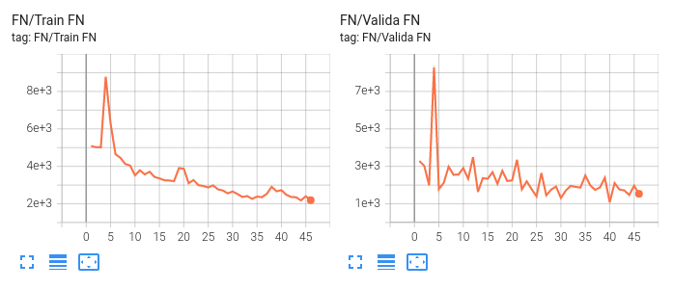
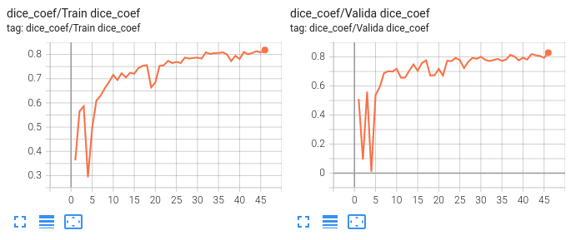
Pytorch version - S1 SGD-Net (backbone: Res18[U-net])

